Slide 1
Tag Clouds Revisited
Date : 2011/12/12
Source : CIKM’11
Speaker : I- Chih Chiu
Advisor : Dr. Koh. Jia-ling

Slide 2
Index
Introduction
Tag Selection Framework
Tag Selection Strategies
Based on Frequency
Based on Diversity
Based on Rank Aggregation
Evaluation Methodology
Experimental Evaluation
Conclusions

Slide 3
Introduction
Tagging has become a very common feature in Web 2.0 applications, providing a simple and effective way for users to freely annotate resources to facilitate their discovery and management.
Tag clouds have become popular as a summarized representation of a collection of tagged resources.

Slide 4
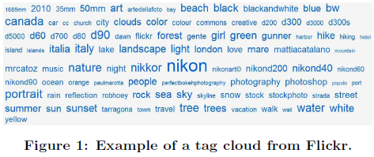
Introduction
Motivation
How effective is the strategy of ranking tags in item collections based on their frequency?
Are there any better strategies for this task?

Slide 5
Tag Selection Framework
Definition:
G : A set of (possibly overlapping)groups
U : A set of objects
T : A set of tags
$T(u)$: The set of tags assigned to an object u.
$U(t)$: The set of objects tagged with t
u1
u3
t₁ t₃
t₁ t₃ t₄
u2
t₁ t₃ t₅
$$T(G)=\{t1,t2,t3,t4,t5\}$$
t₁ t₂ t₅
t₁ t₂ t₃ t₄ t₅
u4
u5
group G

Slide 6
Tag Selection Framework
Define the overall utility value of T_{G}
$r$(t) is the rank of a tag
$f$(t) is a scoring function
$α$() is a discount function
={t₁,t₂,t₃,t₄,t₅}
u1
u3
t₁ t₃
t₁ t₃ t₄
T_{G}={t₁,t₃,t₅}
Assume $β$ = 0.5
u2
t₁ t₃ t₅
$$F\left(TG\right)=\frac{α\left(1\right)f\left(t1\right)+α\left(2\right)f\left(t3\right)+α\left(3\right)f(t5)}{3}$$
$=\frac{0.66∗f\left(t1\right)+0.5∗f\left(t3\right)+0.4∗f(t5)}{3}$
t₁ t₂ t₅
t₁ t₂ t₃ t₄ t₅
u4
u5
group G

Slide 7
Tag Selection Framework
The optimal tag cloud for G is the set T_{G} that is a subset of T(G) with size k and maximizes the utility function F
Propose different tag selection methods based on different approaches for defining the utility function f for the members of the tag cloud.
T_{G}={t₁,t₂,t₃}
T_{G}={t₁,t₂,t₄}
T_{G}={t₁,t₂,t₅}
…
T_{G}={t₃,t₄,t₅}

Slide 8
Tag Selection Strategies
Base on Frequency
Frequency scoring
TF.IDF scoring
Graph-based scoring
Based on Diversity
Diversity
Novelty
Based on Rank Aggregation

Slide 9
Based on Frequency
Frequency scoring
The number of objects to which a tag is assigned.
$f\left(t1\right)=\frac{5}{5}$ = 1
$f\left(t2\right)=\frac{2}{5}$ = 0.4
$f\left(t3\right)=\frac{4}{5}$ = 0.8
$f\left(t4\right)=\frac{2}{5}$ = 0.4
$f\left(t5\right)=\frac{3}{5}$ = 0.6
u1
u3
t₁ t₃
t₁ t₃ t₄
u2
t₁ t₃ t₅
t₁ t₂ t₅
t₁ t₂ t₃ t₄ t₅
u4
u5
group G

Slide 10
Based on Frequency
TF.IDF scoring
The computation of the utility score of a tag t with respect to a group G relies not only on the contents of this particular group but also on the contents of the other groups in the collection.
$$fr\left(t,G\right)=\frac{|U\left(t\right)|}{|G|}$$
u1
u3
t₁ t₃
t₁ t₃ t₄
u2
t₁ t₃ t₅
$$f\left(t5\right)=fr\left(t5,G\right)∙idf\left(t5\right)$$
$$=\frac{3}{5}∙log\frac{10}{3}$$
t₁ t₂ t₅
t₁ t₂ t₃ t₄ t₅
u4
u5
group G

Slide 11
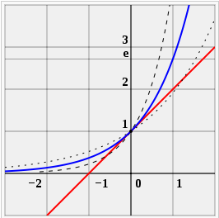
Based on Frequency
Graph-based scoring
Considering combinations of tags that occur together rather than individual tags may be more informative.
$$f0\left(t\right)=fr\left(t,G\right)=\frac{|U(t)|}{|G|}$$
n_{sky}=log|U(t_{sky})|=log 9
n_{sea}=log|U(t_{sea})|=log 8
n_{sky,sea}=log|U(t_{sky}) $∩$ U(t_{sea})|=log 4
Google similarity distance

Slide 12
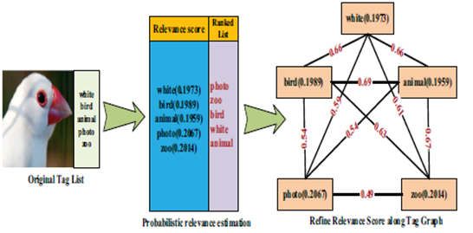
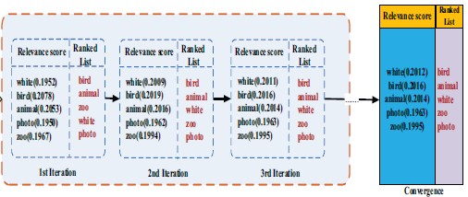
Based on Frequency
Graph-based scoring

Slide 13
Based on Diversity
Diversity
To select tags that are as dissimilar as possible from each other, in the sense that appear indifferent sets of objects.
t={beach}
sim(beach,sea)
sim(beach,sky)
sea,sky
t={forest}
sim(forest,sea)
sim(forest,sky)

Slide 14
Based on Diversity
Novelty
To emphasize on the novelty of newly selected tags, while the cloud is constructed.
$V\left(t\right)=U\left(t\right)$
$nv,TG=|\{ti∈TG :v∈V(ti)\}|$
$r()$ : discount function
$NV=|G|$
This function can be defined to return 1 if n_{v,TG} = 0, and 0 otherwise.
For example, a tag t appears only in a single object u, and there is already another tag of u in the cloud, then the utility score of t is 0.
sea,sky
T_{G}
sea,beach,sun
u

Slide 15
Based on Rank Aggregation
The order in which the tags appear in these objects.
Define a utility function based on the Borda Count method.
Assume $β$ = 0.5
u1
u3
t₁ t₃
t₁ t₃ t₄
$$f\left(t5\right)=\frac{\frac{2}{3}+\frac{2}{3}+\frac{2}{3}}{5}=0.4$$
u2
t₁ t₃ t₅
$$f\left(t1\right)=\frac{\frac{1}{2}+\frac{2}{5}+\frac{2}{5}+\frac{2}{5}+\frac{2}{7}}{5}=0.397$$
t₁ t₂ t₅
t₁ t₂ t₃ t₄ t₅
u4
u5
group G

Slide 16
Evaluation Methodology
Metrics for Search and Navigation
Coverage
Overlap
Selectivity
User Navigation Model
Group Recommendation Accuracy

Slide 17
Metrics for Search and Navigation
Coverage
Since a tag cloud aims at providing an entry point for searching and navigating.
For every object, at least one of its tags should appear in the tag cloud.
u1
u3
$$TG1=\left\{t2,t4\right\}$$
$$coverage\left(TG1\right)=\frac{3}{5}$$
$$TG2=\left\{t1,t3\right\}$$
$$coverage\left(TG2\right)=\frac{5}{5}=1$$
t₁ t₃
t₁ t₃ t₄
u2
t₁ t₃ t₅
t₁ t₂ t₅
t₁ t₂ t₃ t₄ t₅
u4
u5
group G

Slide 18
Metrics for Search and Navigation
Overlap
It would like to avoid cases where different tags in the cloud, when selected, lead to the same or very similar subsets of objects.
$$TG1=\left\{t2,t4\right\}$$
$$overlap\left(TG1\right)=\frac{\frac{1}{2}+\frac{1}{2}}{2∙1}=0.5$$
$$TG2=\left\{t1,t3\right\}$$
$$overlap\left(TG2\right)=\frac{\frac{4}{4}+\frac{4}{5}}{2∙1}=0.9$$
u1
u3
t₁ t₃
t₁ t₃ t₄
u2
t₁ t₃ t₅
t₁ t₂ t₅
t₁ t₂ t₃ t₄ t₅
u4
u5
group G

Slide 19
Metrics for Search and Navigation
Selectivity
A tag cloud should facilitate users to drill down to specific objects of interest.
u1
u3
$$TG1=\left\{t2,t4\right\}$$
$$selectivity\left(TG1\right)=\frac{\frac{0}{5}+\frac{0}{5}+\frac{3}{5}+\frac{3}{5}+\frac{4}{5}}{5}=0.4$$
$$TG2=\left\{t1,t3\right\}$$
$$selectivity\left(TG2\right)=\frac{\frac{1}{5}+\frac{1}{5}+\frac{1}{5}+\frac{0}{5}+\frac{1}{5}}{5}=0.16$$
t₁ t₃
t₁ t₃ t₄
u2
t₁ t₃ t₅
t₁ t₂ t₅
t₁ t₂ t₃ t₄ t₅
u4
u5
group G

Slide 20
User Navigation Model
The goal is to measure the total cost for finding an item.
c_{p} : The cost of scanning one page of objects.
c_{t} : Set the cost of selecting a tag is equal to scanning n_{p} pages, i.e., c_{t}=n_{p}$∗$c_{p}
n₁ : Tag selections , n₂ : Page scans.
n₀ $=\left\lceil {|G|}/{(page_size)}\right\rceil$
$nav_cost=$ $\frac{2∙(2∙0.5)+4∙0.5}{{200}/{10} ∙ 0.5 }=\frac{4}{10}$

Slide 21
Group Recommendation Accuracy
They have considered the task of using the tag cloud to find items of interest within a group.
Another important and common task is to recommend groups for new items.
u
t₂ t₅ t₆
u1
u3
t₁ t₃
t₁ t₃ t₄
u2
t₁ t₃ t₅
Assume $β$ = 0.5
T_{G}={t₂,t₄}
t₁ t₂ t₅
t₁ t₂ t₃ t₄ t₅
$$sim\left(u,G\right)=\frac{\frac{1}{0.5∙1+1}}{3}=\frac{2}{9}$$
u4
u5
group G

Slide 22
Experimental Evaluation
Dataset
Top 60 groups.
2000 photos for each group

Slide 23
Results
Coverage, Overlap and Selectivity
Increasing the size of the tag cloud improves the performance of all methods in all metrics.

Slide 24
Results
Navigation Cost
The navigation cost is affected by coverage and selectivity.
The navigation cost decreases for all methods as the tag cloud size increases.

Slide 25
Results
Recommendation Accuracy
The goal is to recommend groups for this photo based on their tag clouds.

Slide 26
Conclusions
Methods employing diversification or rank aggregation can improve the performance of tag clouds with respect to these metrics, compared to the traditional frequency-based ranking.
There exist several interesting directions for future work, these include extracting semantics of tags and exploiting content-based similarity of objects.

